Slide 1


SEO Proposal
Insert Client Name
Insert Month, Year

Slide 2
Contents
SEO Audit
SEO Implementation Roadmap
Our Methodology
Key People
Case Studies
Next Steps
Appendix

Slide 3
SEO Audit

Slide 4
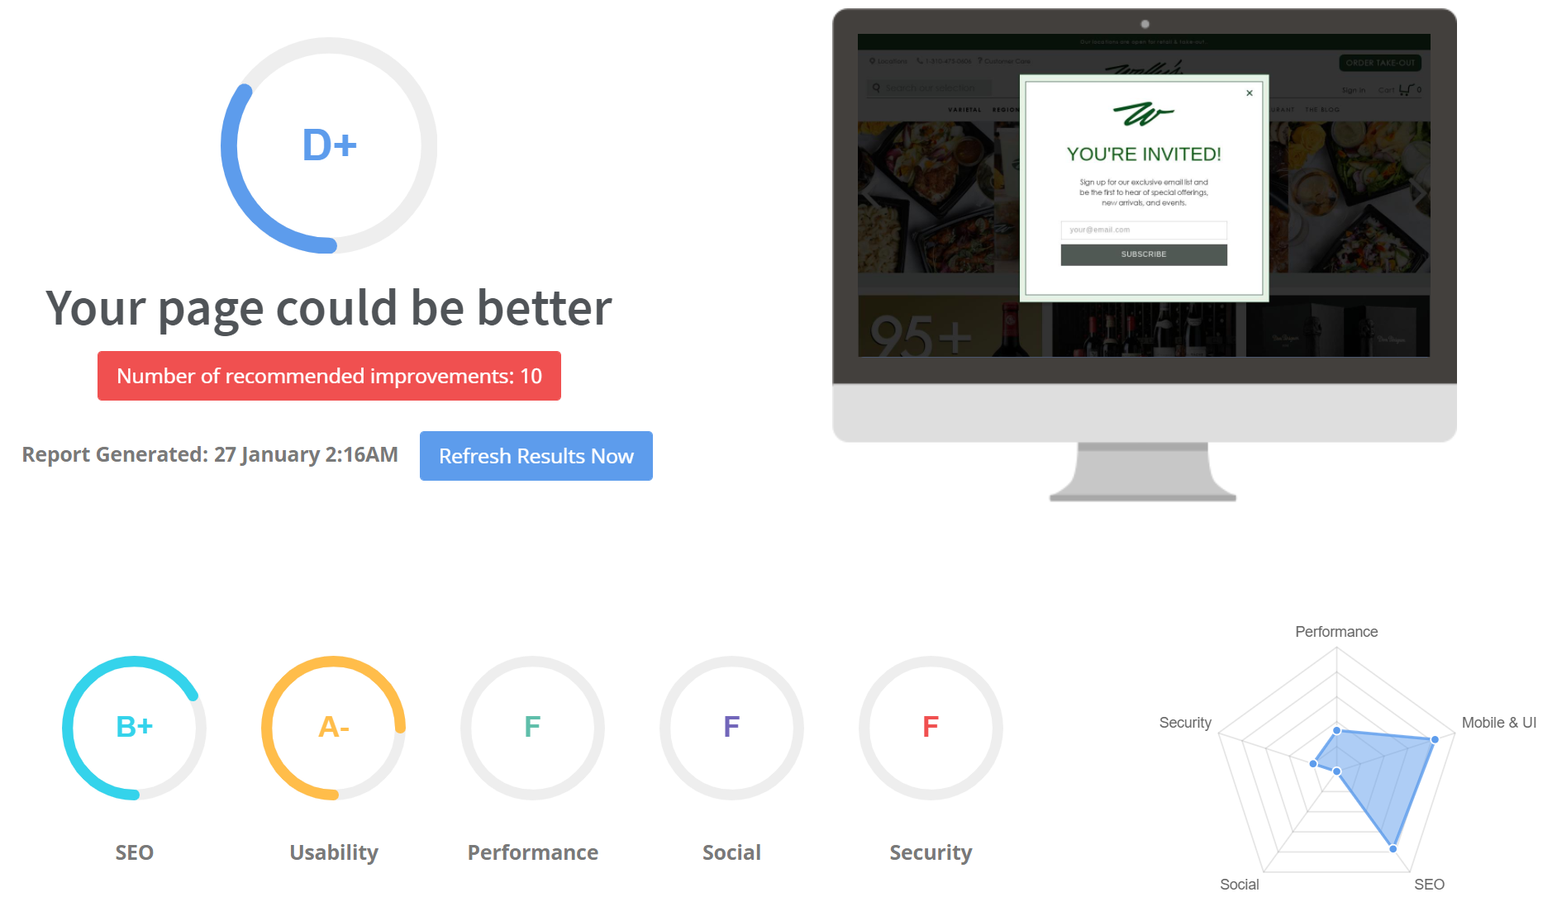
SEO Audit: www.wallywine.com

Slide 5
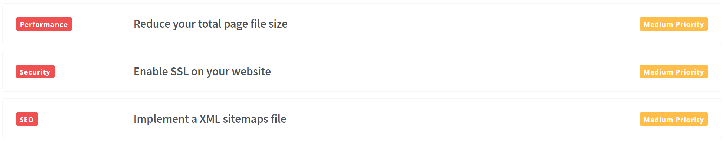
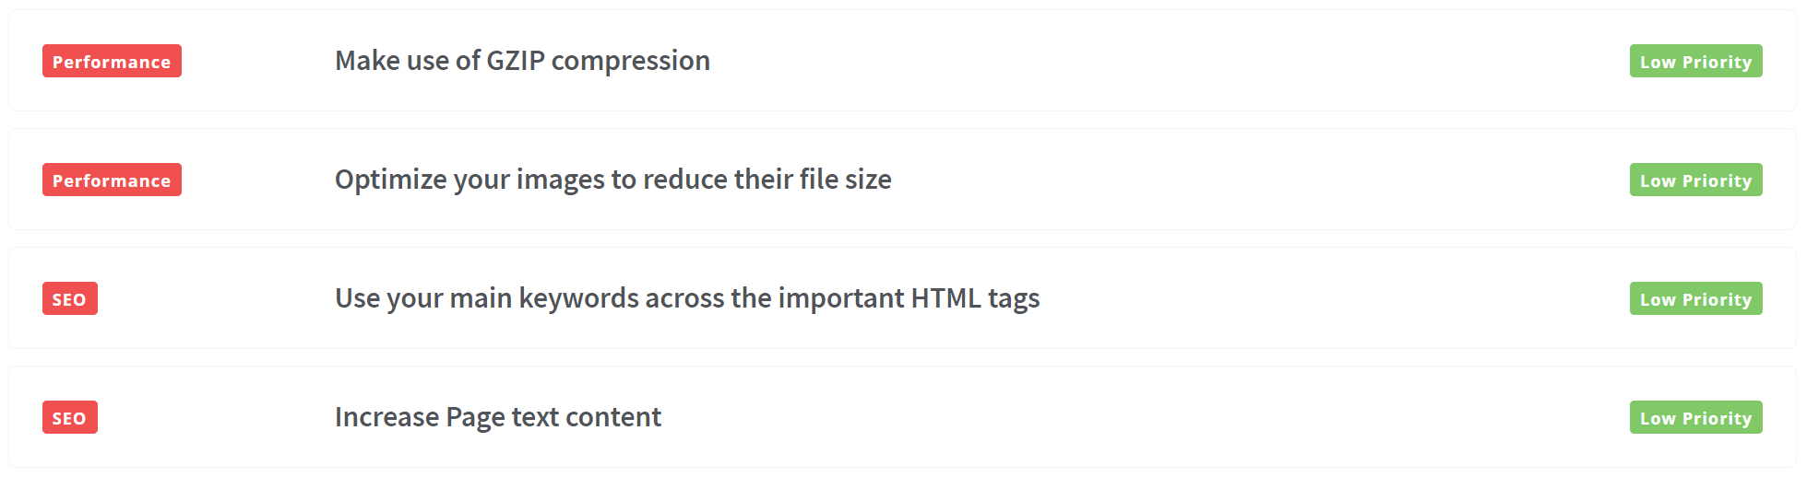
SEO Audit: recommendations

Slide 6
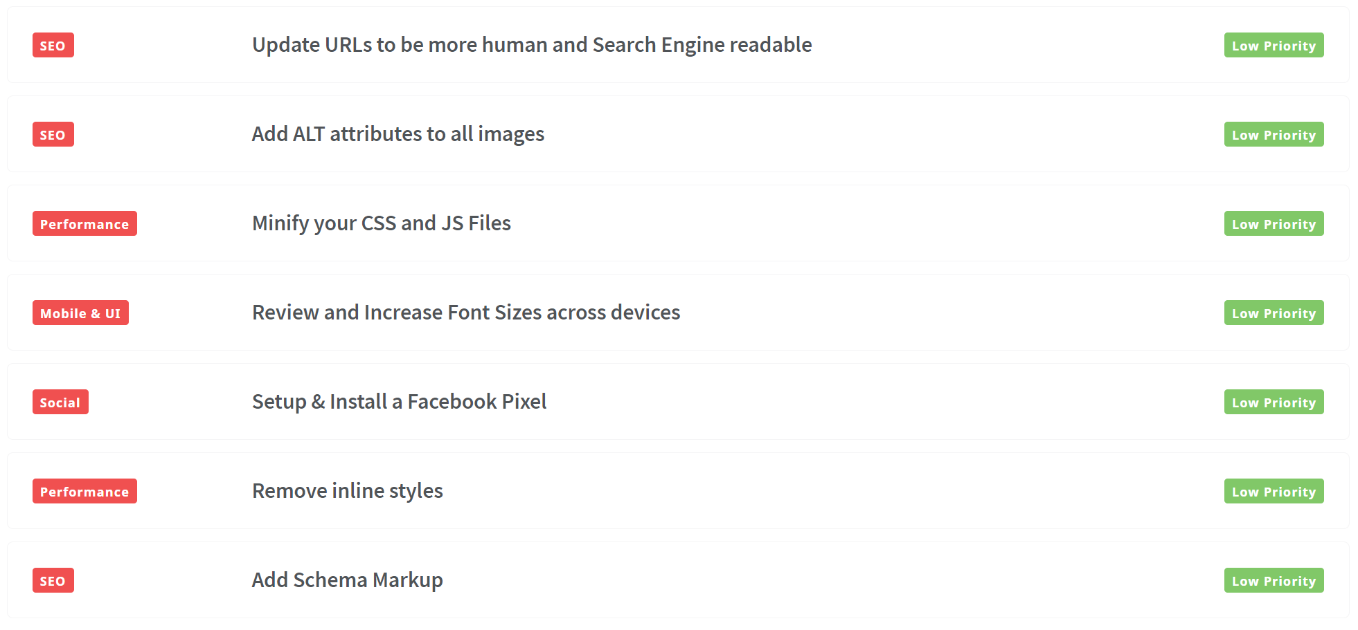
SEO Audit: recommendations

Slide 7
SEO Implementation Roadmap

Slide 8
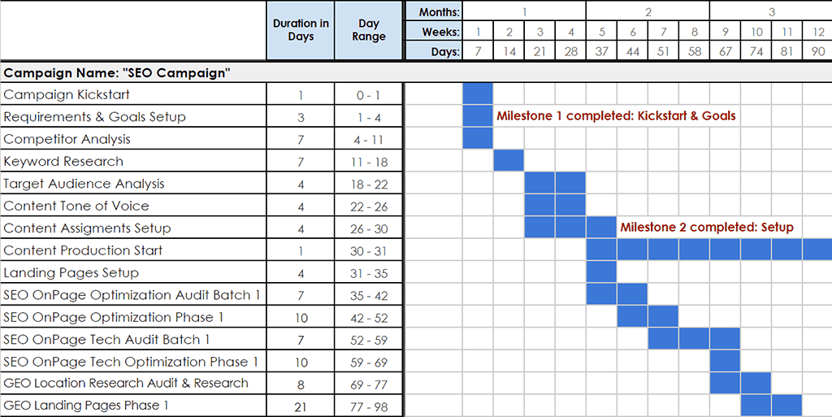
SEO Implementation Roadmap
Insert gantt chart / timeline

Slide 9
Our Methodology

Slide 10
Our Methodology
Insert your agency’s SEO methodology, values and unique selling proposition
Insert agency image

Slide 11
Key People

Slide 12
Key People
List the key people who will be working on the project and a bio/description for each
Insert headshot

Slide 13
Case Studies

Slide 14
Case Studies
Insert at least 2 case studies or testimonials.
Each case study should highlight different business objectives and how you helped the client achieve success.
Insert screenshot of metrics/results

Slide 15
Next Steps

Slide 16
Next Steps
List the action points and dates if relevant
List the action points and dates if relevant
List the action points and dates if relevant

Slide 17
Appendix

Slide 18
Appendix
Add all your data slides here

Slide 19

Save time and automate your SEO Audits
Visit https://www.seoptimer.com

