Slide 1


Agency Business Plan
Insert Agency Name
Insert Month, Year

Slide 2
Contents
Executive Summary
Mission & Values
Market Research Findings
Competitor Analysis
Unique Selling Proposition (USP)
Service Offering
Go-To-Market (GTM) Plan
Organization Structure & People
Goals & Sales Forecasting
Tools & Tech

Slide 3
Executive Summary
Insert an over-arching statement here about your new agency. Focus on the macro aspects of your new agency and what this document encompasses.

Slide 4
Mission & Values
MISSION
Insert your mission statement here. Think about your ‘why’. This statement should be existential and emotive. Why will this agency exist and why will it do what it does?
VALUES
Insert your values here. Some agencies use a series of 3 to 5 words or short statements that the team can believe in and embody day-to-day.

Slide 5
Market Research Findings
Run a mix of qualitative (ie: interviews) and quantitative (ie: online surveys) research with your target and potential clients. Analyze what you hear and insert the insights from your findings here. This Market Research task is one of the most important things you can do before starting your new agency.

Slide 6
Competitor Analysis
The 2nd part of Market Research is performing a competitor analysis of other agencies in your city or region who will be competing with you. If you are alone because you are targeting a specific industry niche or service, expand your search. Make sure you look at min 3 competitors and analyze their offerings & price points. Insert your findings here.

Slide 7
Unique Selling Proposition (USP)
Your USP is what sets your new agency apart in the market. You might position your agency differently by the services you offer (or don’t offer) or the industries/categories you service. Insert your USP here and think about whether it is unique enough. Will your USP set you apart in the market when prospective clients are shopping around for an agency?

Slide 8
Service Offering
List your services here. Be specific about the type of work you offer and what tasks and outcomes your future clients are buying from you. Include descriptions and ballpark prices on this slide.

Slide 9
Go-To-Market (GTM) Plan
Insert all the ways you will prospect for and attract new clients. List the activities you will do like local networking events, SEO, advertising, trade shows, online marketing, etc. Think about your target clients and the methods that will be the most effective in reaching them.

Slide 10
Organization Structure & People
If you are starting small, that’s fine. Perhaps you can think about future roles that you’ll need to hire for. What will your organization structure look like in 12 or 24 months time?

Slide 11
Goals & Sales Forecasting
Insert your projections here about what revenue goals you need to hit to break even and then to drive profit. Based on your target market and service offering, how many clients will you need to onboard in your first 12 months?

Slide 12
Tools & Tech
List all the tools and technology you will need to run your agency. From project management to accounting/invoicing to communications tools to martech, adtech and other subscription software.

Slide 13
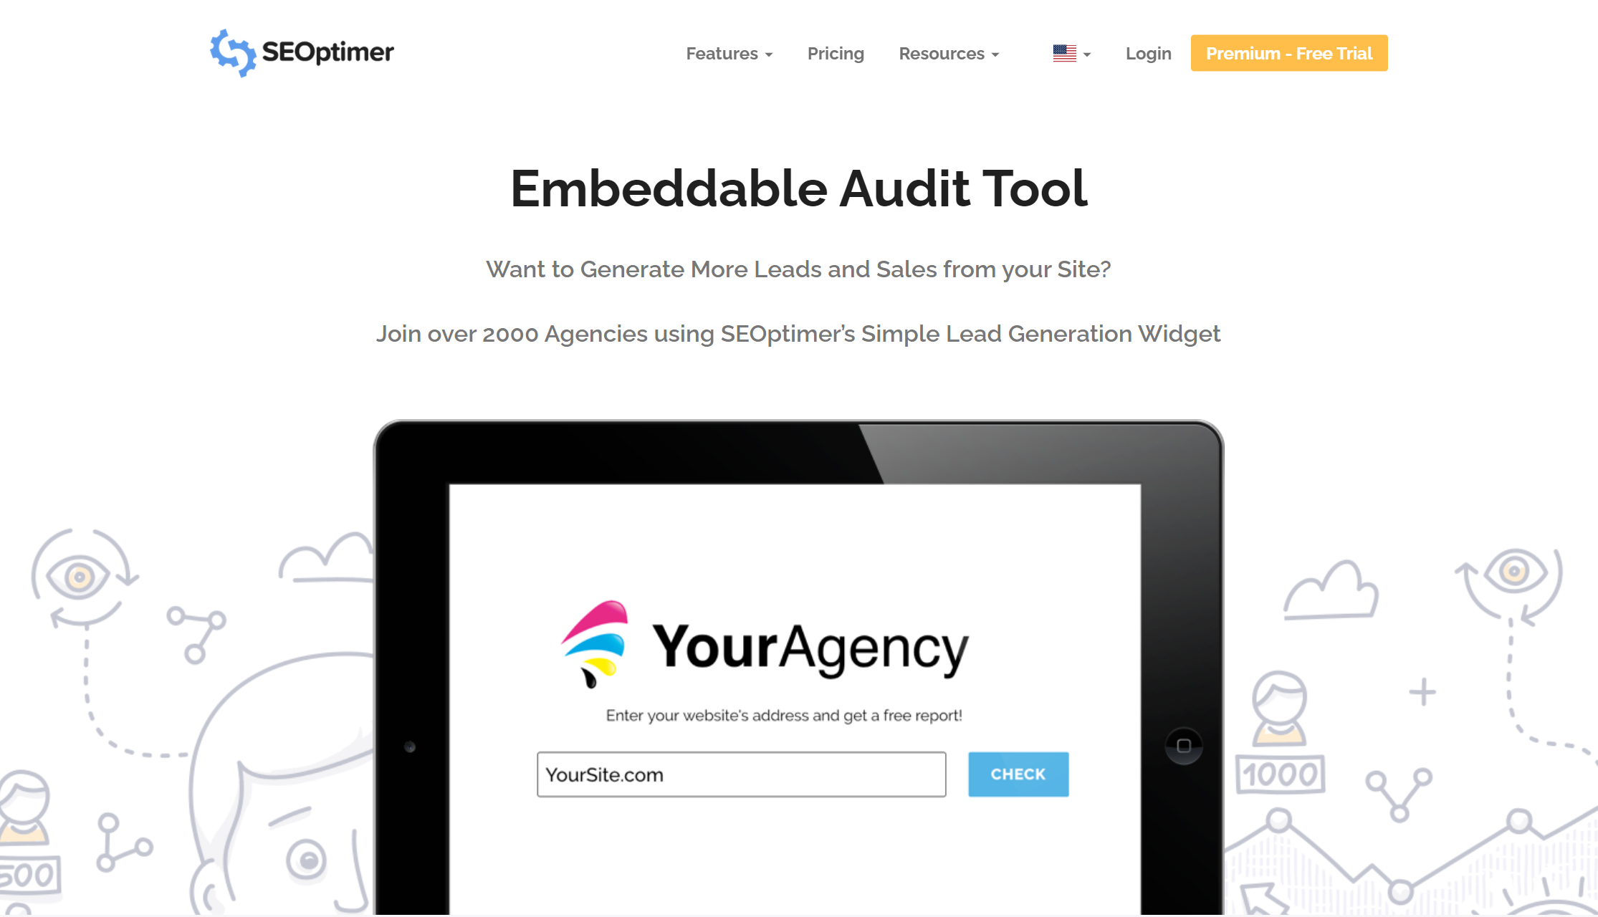
Generate New Business Leads with SEOptimer
Visit https://www.seoptimer.com

